Slide 1

Expense Statistics
.Personal Household Expenses Online Application
Student：Jianquan Liang
ID：2201546

Slide 2
01
Outline
02
Project Description
03
Project Plan
CONTENTS
目录
04
Features description and screenshots
05
Challenges
06
Learning outcomes

Slide 3


Part 01
Outline

Slide 4
Outline
1
Familiar API
Through the project in-depth understanding of the use of API in the website project.
2
MVC pattern
Get familiar with the entire MVC pattern by developing small projects using MVC.
3
Development Process
Through the project, familiar with the development process

Slide 5
Part 02
Project Description

Slide 6
Project Description
Document
GITHUB，PowerDesigner
Use DataBase
Deployment strategy
Mysql
local：XAMPP+PHP
aws：Elastic Beanstalk+RDS(Mysql)
development environment
Other plugins
XAMPP+PHP+javascript+HTML
bootstrap,chart(Graphical display of data)

Slide 7

Project Description
Personal accounting
application
Record daily expenses and check monthly income and expenditure.
Realize graphic presentation

Slide 8
Part 03
Project Plan

Slide 9
Project Plan
test
Idea
Design
Implement
Deploy
complete
Study

Slide 10
Part 04
Features and screenshots

Slide 11
Features and screenshots
1
2
3
Login
Fee type management
Fee record
User login, record personal expenses
Type of fee required for user entry
4
5
6
Type List
Fee list
statistics
Show all types
List of monthly impression fee
Graphically display expenses by month, or show the balance of income and expenses

Slide 12
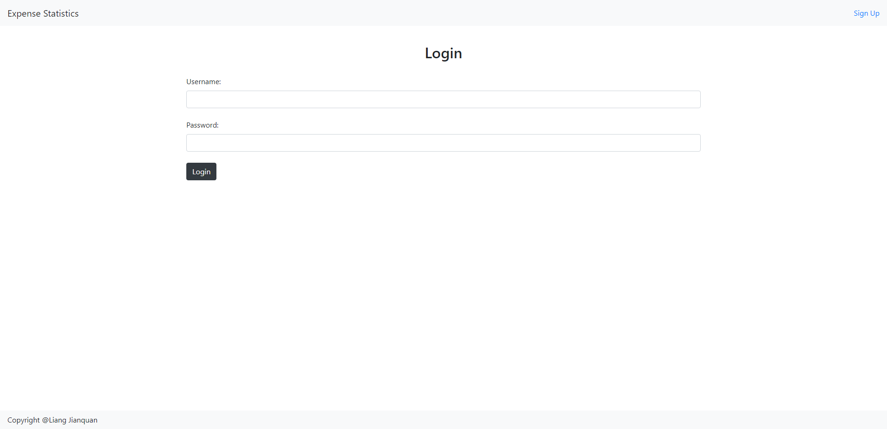
Features and screenshots

Slide 13
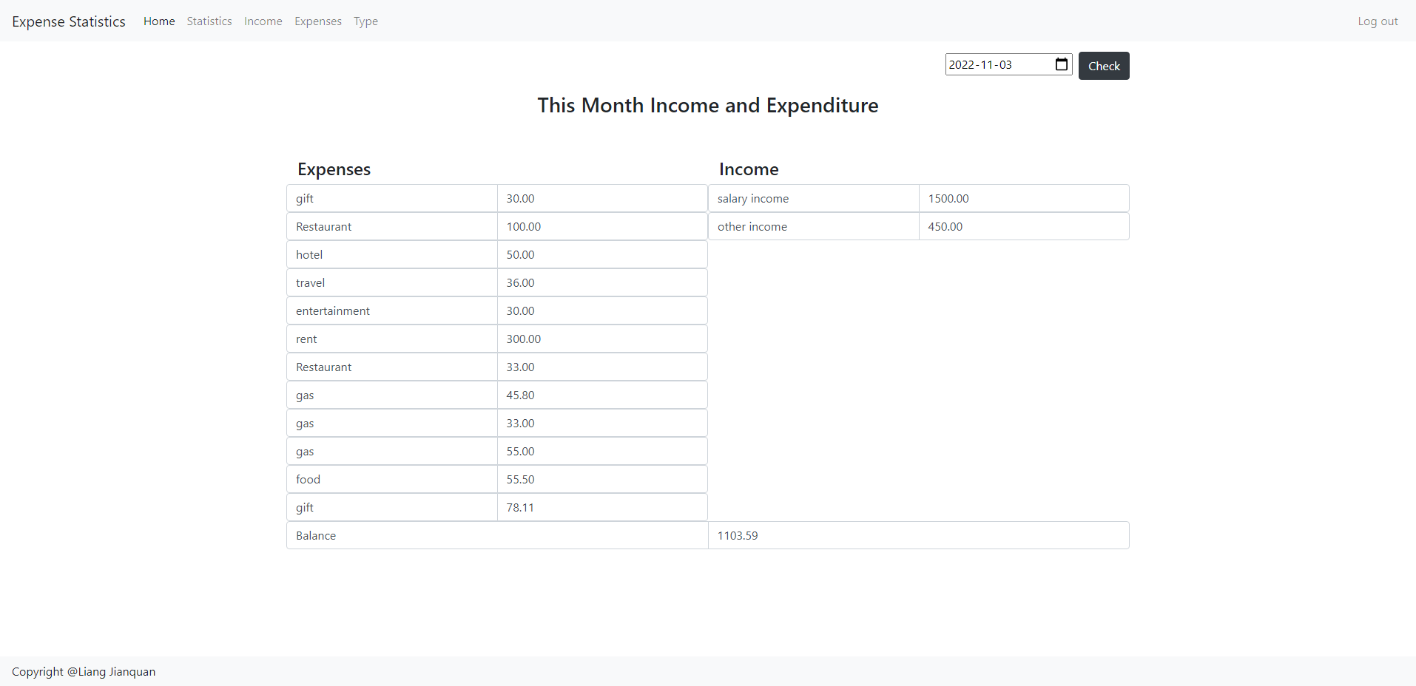
Features and screenshots

Slide 14
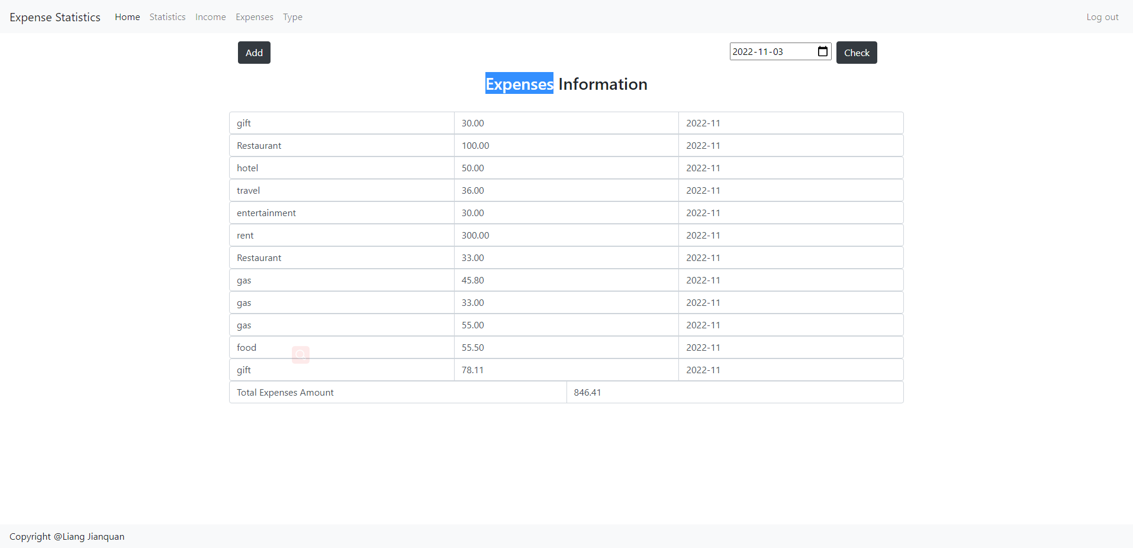
Features and screenshots

Slide 15
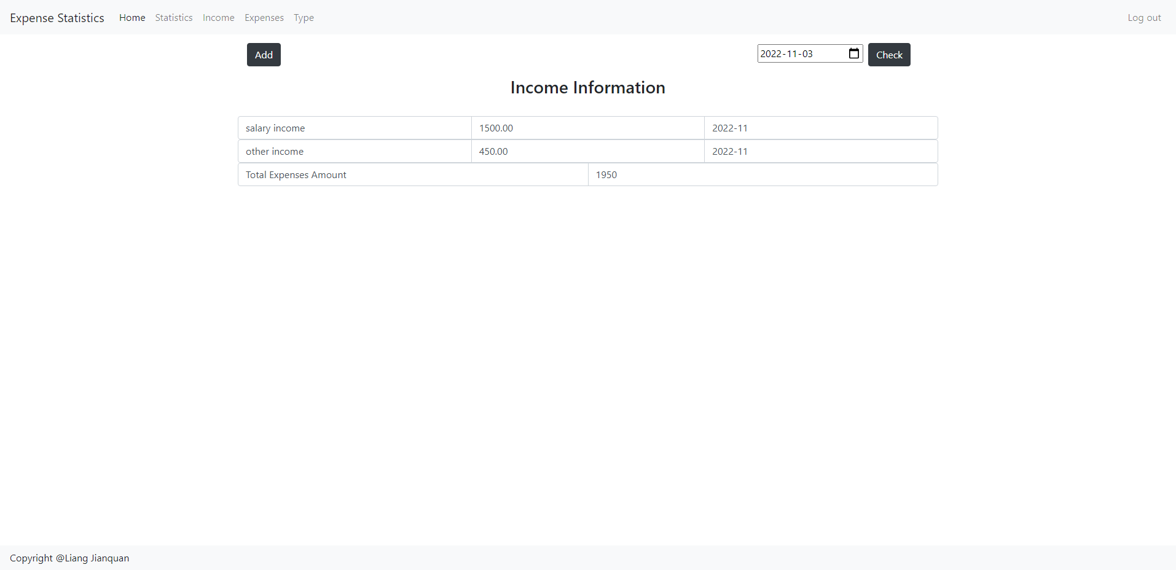
Features and screenshots

Slide 16
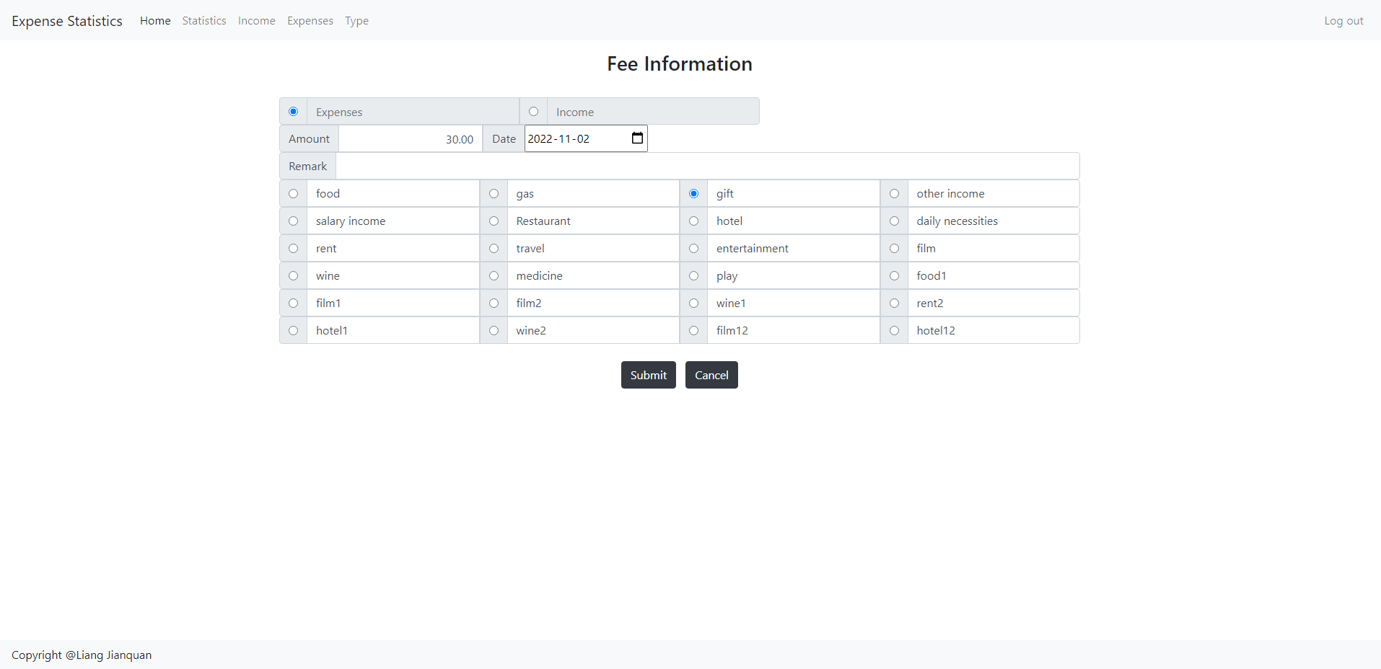
Features and screenshots

Slide 17
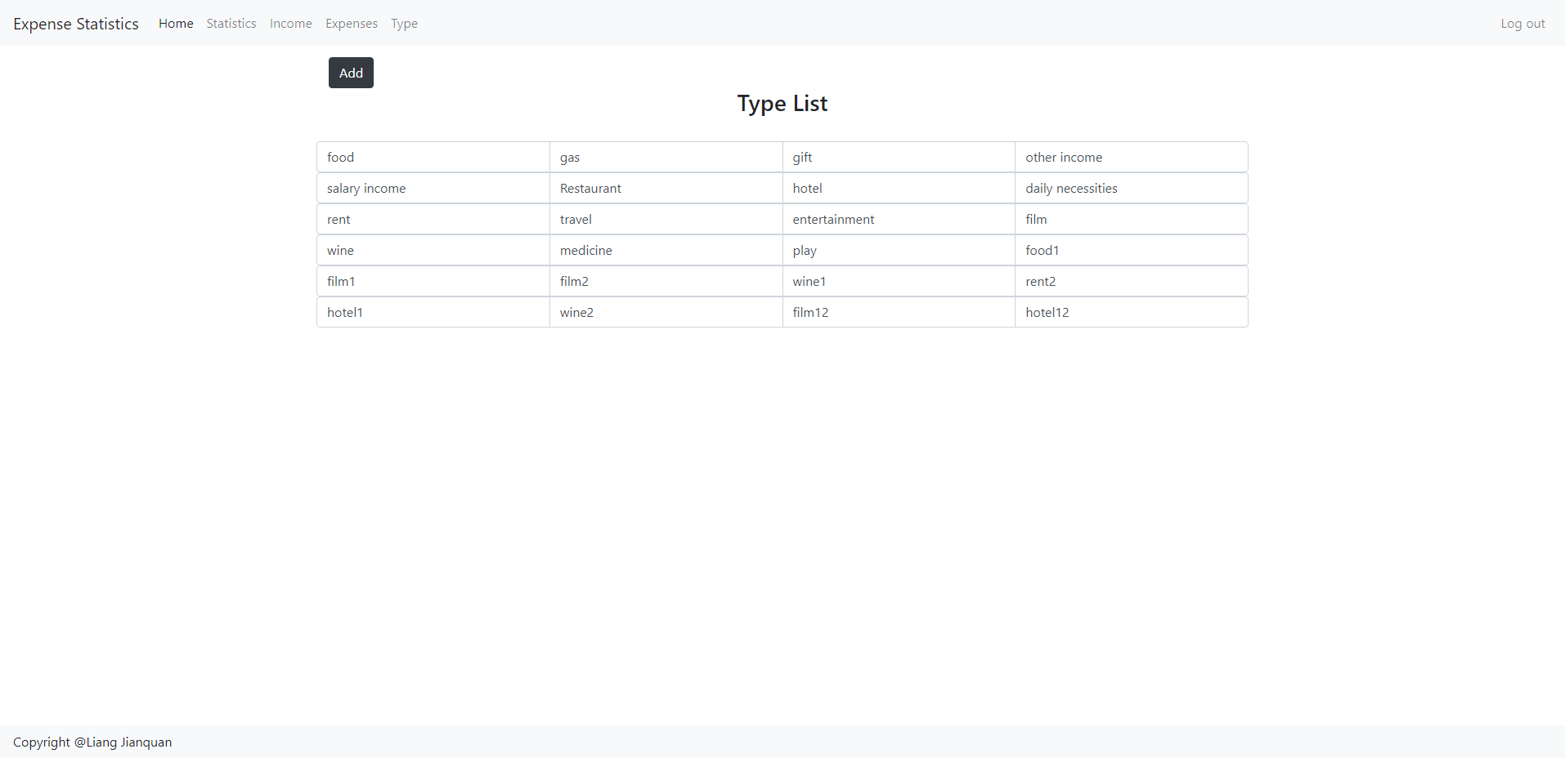
Features and screenshots

Slide 18
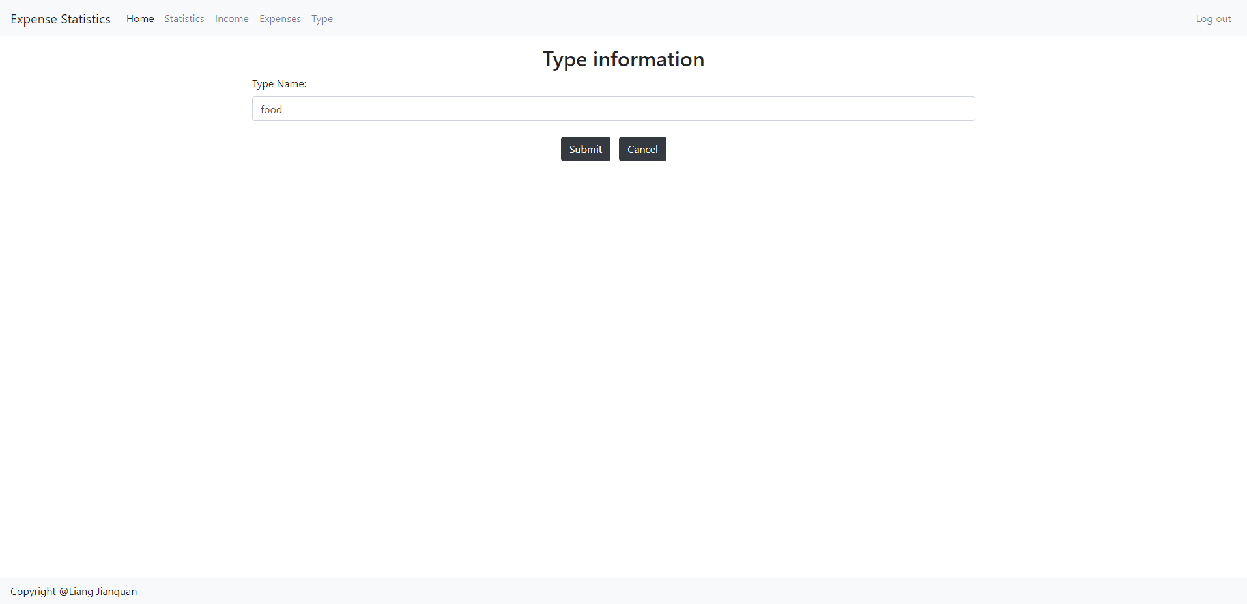
Features and screenshots

Slide 19
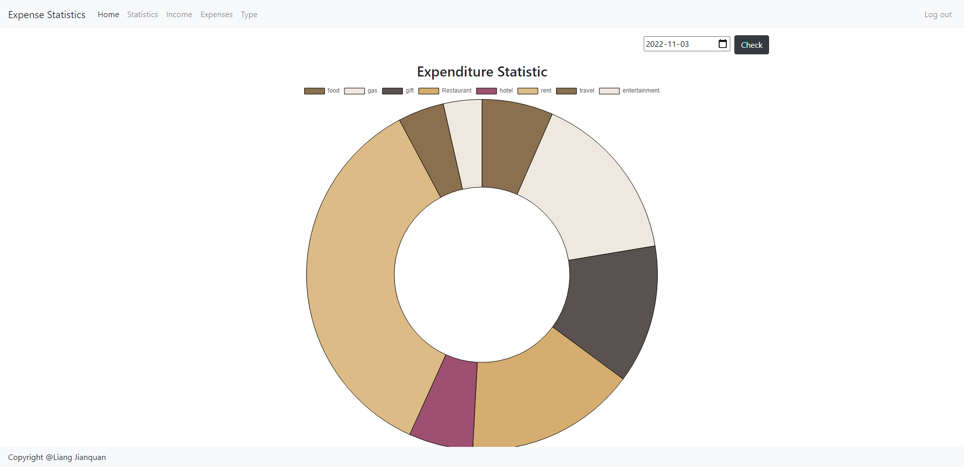
Features and screenshots

Slide 20
Part 05
Challenges

Slide 21
Challenges
MVC
Code
Plugin
Time
Building your own MVC development model is challenging
Writing HTML code in PHP is not easy
Implementing the chart plugin in PHP is challenging
Time is relatively short, and some functions have not been perfected, but the basic functions have been realized.

Slide 22
Part 06
Learning outcomes

Slide 23

Learning outcomes
During this study period, I learned more about technology and knowledge of website development. For example, MVC pattern development, AWS deployment website, graphic plugin usage, bootstrap usage, etc. The knowledge learned in the course and extracurricular is all applied and reflected in the small project. Although there is still a gap between the completion of the small project and the expected content, I will improve it in the future.

Slide 24
Thank you
Reported by：Jianquan Liang

